Slide 1
Evolutionary Algorithms

Slide 2
Overview
Introduction to Optimization
Optimization Procedure
Different Optimization Algorithms
Evolutionary Algorithm

Slide 3
What is Optimization?
The process of searching for the optimal solution from a set of candidates to the problem of interest based on certain performance criteria.
Accomplish a predefined task to the highest standard.
-Job Shop Problem
Produce maximum yields given limited resources.
-Investment Strategy

Slide 4
Calculus
Maximum and minimum of a smooth function is reached at a stationary point where its gradient vanishes.

Slide 5

Goal of Optimization
Find values of the variables that minimize or maximize the objective function while satisfying the constraints.
Objective Function
x₁
x_{n}
f
Output
f(X)=∑x_{i}²

Slide 6
Component of Optimization Problem
Objective Function: An objective function which we want to minimize or maximize.
In a manufacturing process, we might want to maximize the profit or minimize the cost.
In fitting experimental data to a user-defined model, we might minimize the total deviation of observed data from predictions based on the model.
In designing an inductor, we might want to maximize the Quality Factor and minimize the area.

Slide 7
Component of Optimization Problem
Design Variables: A set of unknowns or variables which affect the value of the objective function.
In the manufacturing problem, the variables might include the amounts of different resources used or the time spent on each activity.
In fitting-the-data problem, the unknowns are the parameters that define the model.
In the inductor design problem, the variables used define the layout geometry of the panel..

Slide 8
Component of Optimization Problem
Constraints: A set of constraints that allow the unknowns to take on certain values but exclude others.
For the manufacturing problem, it does not make sense to spend a negative amount of time on any activity, so we constrain all the "time" variables to be non-negative.
In the inductor design problem, we would probably want to limit the upper and lower value of layout parameters and to target an inductance value within the tolerance level.

Slide 9
Are All necessary?
Almost all optimization problems have objective function.
Variables are essential. If there are no variables, we cannot define the objective function and the problem constraints.
Constraints are not essential.
In fact, the field of unconstrained optimization is a large and important one for which a lot of algorithms and software are available.

Slide 10
What We need for optimization
Model: Modeling is the process of identifying objective function, variables and constraints.
Algorithm: An effective and reliable numerical algorithm is needed to solve the problem.
There is no universal optimization algorithm. Algorithm should have robustness (good performance for a wide class of problems), efficiency (not too much computer time) and accuracy (can identify the error)

Slide 11
Flowchart of Optimal Design Procedure
Need for optimization
Choose design variables
Formulate constraints
Formulate objective function
Set up variable bounds
Select an optimization algorithm
Obtain solution(s)

Slide 12
Mathematical Formulation of Optimization Problems

Slide 13
Constraints
Inequality constraints: x₁² – x₂²0
Equality constraints: x₁ = 2

Slide 14
Variable Bounds
Maximum and minimum bounds on each design variable.
Variable bounds are used to confine the search algorithm within these bounds.
Ex:

Slide 15
Classification of Optimization Methods
Single variable
Multi-variable
Constrained
Non-constrained
Single objective
Multi-objective
Linear
Non-linear

Slide 16
Local and Global Optimizers
A local minimizer, x_{B}*, of the region B, is defined so that:
f(x_{B}*) f(x), x B.
Ex: Gradient based search methods
Shortcomings: 1) One requires an initial guess to start with. 2) Convergence to an optimal solution depends on the chosen initial guess. 3) Most algorithms tend to get stuck to a sub-optimal solution. 4) An algorithm efficient in solving one optimization problem may not be efficient in solving another one. 5) These are useful over a relatively narrow range.
The global optimizer, x* , is defined so that f(x*) f(x), x S where S is the search space.
Ex. Genetic Algorithm, Particle Swarm Optimization etc.

Slide 17
Local and Global Optimizers

Slide 18
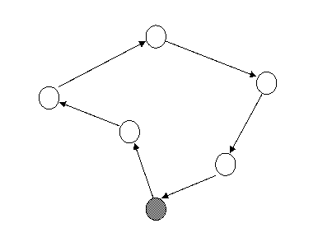
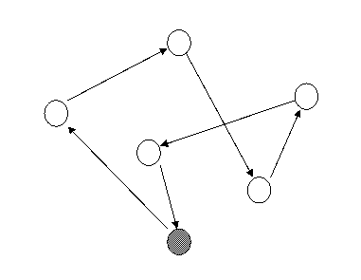
Travelling Salesman Problem (Combinatorial Explosion)
Some Optimization Problems
There are 20!=2,432,902,008,176,640,000 different routes for a 20-city problem.

Slide 19
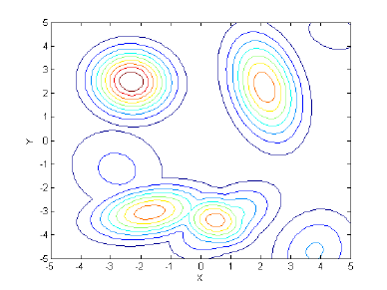
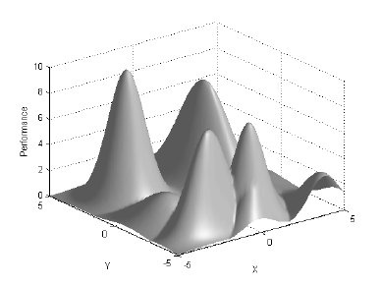
Challenge: Dimensionality
Some Optimization Problems
The size of the search space grows exponentially!

Slide 20
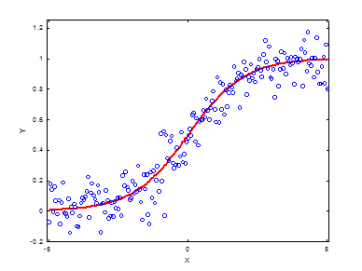
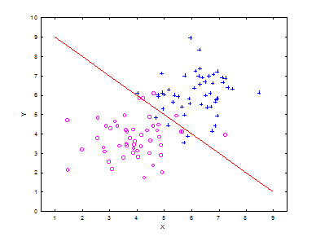
Machine Learning Problems
Some Optimization Problems
Regression
Classification

Slide 21
Challenge: Local Optima
Some Optimization Problems
f
f
f
0
X
0
X
0
X
Easy
Challenging
Average

Slide 22
How to solve it?
Multimodal
Local Search
f
X
0

Slide 23
Evolutionary Algorithms
Genetic Algorithm (GA)
Particle Swarm Optimization (PSO)
Differential Evolutionary Algorithm (DE)

Slide 24
Introduction to Genetic Algorithms
A class of probabilistic optimization algorithms
Inspired by the biological evolution process
Uses concepts of “Natural Selection” and “Genetic Inheritance” (Darwin 1859)
Originally developed by John Holland (1975)
Particularly well suited for hard problems where little is known about the underlying search space

Slide 25
Natural selection
A process called natural selection, ‘selects’ individuals best adapted to the environment.
Those fittest survive longest.
Characteristics, encoded in genes are transmitted to offspring and tend to propagate into new generations.
An offspring’s characteristics are partially inherited from parents.
A genetic algorithm maintains a population of candidate solutions for the problem at hand, and makes it evolve by iteratively applying a set of stochastic operators

Slide 26
Stochastic operators
Selection replicates the most successful solutions found in a population at a rate proportional to their relative quality
Recombination decomposes two distinct solutions and then randomly mixes their parts to form novel solutions
Mutation randomly perturbs a candidate solution

Slide 27
Genetic Algorithm
produce an initial population of individuals
evaluate the fitness of all individuals
while termination condition not met do
select fitter individuals for reproduction
recombine between individuals
mutate individuals
evaluate the fitness of the modified individuals
generate a new population
End while

Slide 28
The Evolutionary Cycle
parents
selection
modification
modified
offspring
initiate &
population
evaluation
evaluate
evaluated offspring
deleted
members
discard

Slide 29
Terminology
Gene–a single encoding of part of the solution space, i.e. either single bits or short blocks of adjacent bits that encode an element of the candidate solution
Chromosome–a string of genes that represents a solution in the population
Population–the number of chromosomes available to test
Candidate solutions to the optimization problem play the role of individuals in a population (or chromosomes)
Parameter – a variable in the system of interest
Cost/fitness/objective function – A value we are trying to maximize/ minimize

Slide 30
Representation/Encoding
Encoding of chromosomes is the first step and it depends entirely on the problem heavily
The process of representing the solution in the form of a string of bits that conveys the necessary information.
Just as in a chromosome, each gene controls a particular characteristic of the individual, similarly, each bit in the string represents a characteristic of the solution
All kind of alphabets can be used for a chromosome (numbers, characters), but generally a binary alphabet is used
Order of genes on chromosome can be important
Good coding is probably the most important factor for the performance of a GA

Slide 31
Encoding Methods
Binary Encoding – Most common method of encoding. Chromosomes are strings of 1s and 0s and each position in the chromosome represents a particular characteristic of the problem.
Chromosome A
10110010110011100101
Chromosome B
11111110000000011111
Permutation Encoding – Useful in ordering problems such as the Traveling Salesman Problem (TSP). Example. In TSP, every chromosome is a string of numbers, each of which represents a city to be visited.
Chromosome A
1 5 3 2 6 4 7 9 8
Chromosome B
8 5 6 7 2 3 1 4 9

Slide 32
Encoding Methods Contd……
Value Encoding – Used in problems where complicated values, such as real numbers, are used and where binary encoding would not suffice.
Good for some problems, but often necessary to develop some specific crossover and mutation techniques for these chromosomes.
Chromosome A
1.235 5.323 0.454 2.321 2.454
Chromosome B
(left), (back), (left), (right), (forward)

Slide 33
Encoding Methods Contd……
Octal encoding is uses string made up of octal numbers (0 – 7)
Hexadecimal encoding is uses string made up of Hexadecimal numbers (0 – 9, A – F)
Chromosome A
0 5 6 2 6 4 7 1 4
Chromosome B
1 5 6 7 0 3 1 6 5
Chromosome A
9 5 C 2 A 4 F
Chromosome B
A 0 6 D 2 B 1

Slide 34
GA Operators
- Initialization
- Selection
- Reproduction
- Termination

Slide 35
Initialization
Initially many individual solutions are randomly generated to form an initial population.
The population size depends on the nature of the problem, but typically contains several hundreds or thousands of possible solutions
Traditionally, the population is generated randomly, covering the entire range of possible solutions (the search space).

Slide 36
Selection Methods
There are many different techniques which a genetic algorithm can use
to select the individuals to be copied over into the next generation (epoch).
Listed are some of the most commonly used:

Slide 37
Roulette-Wheel Selection
Each current string in the population has a slot assigned to it which is in proportion to it’s fitness.
We spin the weighted roulette wheel N times (where n (pop size) is the total number of solutions).
Each time Roulette Wheel stops, the string corresponding to that slot is created.
Strings that are fitter are assigned a larger slot and hence have a better chance of appearing in the new population.
Values
1 | 8.2
2 | 3.2
3 | 1.4
4 | 1.2

Slide 38
Ranking Selection
Ranks the population and every chromosome receives fitness from the ranking
The worst has fitness 1 and the best has fitness N
Rank based proportioned selection scheme is expected to perform better than fitness proportioned scheme
Values
Rank
1 | 8.2 | 4
2 | -3.2 | 1
3 | 1.4 | 2
4 | -1.2 | 3

Slide 39
Crossover
Crossover is the process in which two chromosomes (strings) combine their genetic material (bits) to produce a new offspring which possesses both their characteristics.
Two strings are picked from the pool at random, called parents.
The parents will participate in crossover with crossover probability p_{c} , generally near to 1 so that almost all parents can participate in crossover
The process may also be done by random number generation between 0.0 and 1.0
If the random number is less or equal to p_{c} the parent will participate in crossover
The method chosen depends on the Encoding Method.

Slide 40
Single Point Crossover
A random point is chosen on the individual chromosomes (strings) and the genetic material is exchanged at this point.
Parent 1
Parent 2
Offspring 1
Offspring 2
One Point Crossover

Slide 41
Two Point Crossover
Two or more random points are chosen on the individual chromosomes (strings) and the genetic material is exchanged at these points.
Parent 1
Parent 2
Offspring 1
Offspring 2
Two Point Crossover

Slide 42
Mutation
Mutation- is a genetic operator used to maintain genetic diversity from one generation of a population of chromosomes to the next. It is analogous to biological mutation.
Mutation Probability- determines how often the parts of a chromosome will be mutated.
A common method of implementing the mutation operator involves generating a random variable for each bit in a sequence. This random variable tells whether or not a particular bit will be modified.

Slide 43
Mutation
Mutation is mainly used to maintain the genetic diversity.
Parent
Offspring

Slide 44
Termination condition
A pre-determined number of generations or time has elapsed
A satisfactory solution has been achieved
No improvement in solution quality has taken place for a pre-determined number of generations

Slide 45
Example: the MAXONE problem
Suppose we want to maximize the number of ones in a string of l binary digits
An individual is encoded (naturally) as a string of l binary digits
The fitness f of a candidate solution to the MAXONE problem is the number of ones in its genetic code
We start with a population of n random strings. Suppose that l = 10 and n = 6

Slide 46
Example (initialization)
We toss a fair coin 60 times and get the following initial population:
s₁ = 1111010101 f (s₁) = 7
s₂ = 0111000101 f (s₂) = 5
s₃ = 1110110101 f (s₃) = 7
s₄ = 0100010011 f (s₄) = 4
s₅ = 1110111101 f (s₅) = 8
s₆ = 0100110000 f (s₆) = 3

Slide 47
Example (selection1)
Next we apply fitness proportionate selection with the roulette wheel method:
Individual i will have a
probability to be chosen
Repeat the extraction as many times as the number of individuals we need to have the same parent population size (Here 6)
1
2
Area is Proportional to fitness value
n
3
4

Slide 48
Example (selection2)
After performing selection, population is:
s₁` = 1111010101 (s₁)
s₂` = 1110110101 (s₃)
s₃` = 1110111101 (s₅)
s₄` = 0111000101 (s₂)
s₅` = 0100010011 (s₄)
s₆` = 1110111101 (s₆)

Slide 49
Example (crossover1)
Crossover: For each couple to perform crossover or not using probability 0.6.
Suppose that we decide to actually perform crossover only for couples (s₁`, s₂`) and (s₅`, s₆`).
For each couple, we randomly extract a crossover point, for instance 2 for the first and 5 for the second

Slide 50
Example (crossover2)
Before crossover:
s₁` = 1111010101 s₂` = 1110110101
s₅` = 0100010011 s₆` = 1110111101
After crossover:
s₁`` = 1110110101 s₂`` = 1111010101
s₅`` = 0100011101 s₆`` = 1110110011

Slide 51
Example (mutation1)
The final step is to apply random mutation: for each bit that we are to copy to the new population we allow a small probability of error (for instance 0.1)
Before applying mutation:
s₁`` = 1110110101
s₂`` = 1111010101
s₃`` = 1110111101
s₄`` = 0111000101
s₅`` = 0100011101
s₆`` = 1110110011

Slide 52
Example (mutation2)
After applying mutation:
s₁``` = 1110100101 f (s₁``` ) = 6
s₂``` = 1111110100 f (s₂``` ) = 7
s₃``` = 1110101111 f (s₃``` ) = 8
s₄``` = 0111000101 f (s₄``` ) = 5
s₅``` = 0100011101 f (s₅``` ) = 5
s₆``` = 1110110001 f (s₆``` ) = 6
In one generation, the total population fitness changed from 34 to 37, thus improved by ~9%
Go through the same process all over again, until a stopping criterion is met

Slide 54

Particle Swarm Optimization

Slide 55
Overview
What is swarm intelligence?
Biological inspirations
Particle swarm definition
PSO algorithm
Applications

Slide 56
Swarm Intelligence
Population of simple agents with basic rules
No centralized control of agent behavior
High level phenomena emerge from low level specification of rules
See also: Ants, Bees, Cellular Automata

Slide 57
Biological Inspirations
PSO model is derived from real world interactions
Flocks of birds converge to food sources
Schools of fish evade predators
Any similar interactions with social and psychological basis with present objectives

Slide 58


Natural Models
Social-Psychological behaviors of animals
How can birds or fish exhibit such a coordinated collective behavior?

Slide 59
PSO Definition
PSO is a robust stochastic optimization technique based on the movement and intelligence of swarms.
James Kennedy (social-psychologist) and Russell Eberhart (electrical engineer) developed in year 1995.
PSO shares many similarities with GA.
The system is initialized with a population of random solutions and searches for optima by updating generations.
However, unlike GA, PSO has no evolution operators such as crossover and mutation.
In PSO, the potential solutions, called particles, fly through the problem space by following the current optimum particles.

Slide 60
PSO applies the concept of social interaction to problem solving
Simple algorithm, easy to implement and few parameters to adjust mainly the velocity
A “swarm” is an apparently disorganized collection (population) of moving individuals that tend to cluster together while each individual seems to be moving in a random direction
It uses a number of agents (particles) that constitute a swarm moving around in the search space looking for the best solution

Slide 61

Concept
Uses a number of agents (particles) that constitute a swarm moving around in the search space looking for the best solution
Each particle in search space adjusts its “flying” according to its own flying experience as well as the flying experience of other particles

Slide 62
Concept
Collection of flying particles (swarm) - Changing solutions
Search area - Possible solutions
Movement towards a promising area to get the global optimum
Each particle keeps track:
its best solution, personal best, pbest
the best value of any particle, global best, gbest

Slide 63
PSO Definition
Each particle (solution) is treated as a point in a D-dimensional space which adjusts its “flying” according to its own flying experience as well as the flying experience of other particles.
Each particle keeps track of its coordinates in the solution space which are associated with the best solution (fitness) that has achieved so far by that particle. This value is called personal best , pbest
Another best value that is tracked by the PSO is the best value obtained so far by any particle in the neighborhood of that particle. This value is called gbest
The basic concept of PSO lies in accelerating each particle toward its pbest and the gbest locations, with a random weighted acceleration at each time step

Slide 64
Concept of modification of a searching point by PSO
My best perf.
i-proximity
p_{i}
Here I am!
The best perf. of my neighbours
x
p_{g}
g-proximity
v

Slide 65
Geographical Representation of Neighbourhoods
Local Neighborhoods
Global Neighborhoods

Slide 66
What a particle does
Each particle tries to modify its position using the following information:
the current positions and the current velocities
the distance between the current position and pbest
the distance between the current position and the gbest
The modification of the particle’s velocity and position can be mathematically modeled according the following equation :
V_{i}^{t+1} = wV_{i}^{t} +c₁ rand₁().(pbest_{i}-x_{i}^{t}) + c₂ rand₂(). (gbest-x_{i}^{t}) (1)
where, v_{i}^{t} : velocity of agent i at iteration t, w: weighting function, c_{j} : weighting factor, rand : uniformly distributed random number between 0 and 1, x_{i}^{t} : current position of agent i at iteration k, pbest_{i} : pbest of agent i, gbest: gbest of the group.
X_{i}^{t+1} = X_{i}^{t} + V_{i}^{t+1} (2)

Slide 67
Velocity Update
Velocity at next step composed of three components
Includes stochastic multipliers (r₁ and r₂) which explore search space
Position(t + 1) = Position(t) + Velocity(t+1)
inertia
cognitive
social

Slide 68
Inertia Component
“The tendency to stay moving in the current direction”
Value ranges from: 0 ≤ w ≤ 1
Empirically determined but generally a mid range value is used
inertia
cognitive
social

Slide 69
Cognitive Component
“A particle’s memory; tends to return to known good regions”
Values range from: 0 ≤ c₁ ≤ 2
Usually experimentation necessary as cognition depends on the fitness landscape
inertia
cognitive
social

Slide 70
Social Component
“Causes the particle to move to the best known region the swarm has found”
Values range from: 0 ≤ c₂ < 2
Modifications to global best could be social groupings, islands, neighborhoods, etc.
inertia
cognitive
social

Slide 71
Flow chart depicting the General PSO Algorithm
Start
Initialize particles with random position
and velocity vectors.
For each particle’s position (p)
evaluate fitness
Loop until all particles exhaust
If fitness(p) better than
fitness(pbest) then pbest= p
Loop until max iter
Set best of pBests as gBest
Update particles velocity (eq. 1) and
position (eq. 3)
Stop: giving gBest, optimal solution.

Slide 72
Applications
Optimization of function or search space
Biomedical applications
Bioinformatics
Hybrid strategies for evolving ANN weights
Most applications which GA is able to solve !

Slide 73
Comparison with other evolutionary computation techniques
Unlike in genetic algorithms, evolutionary programming and evolutionary strategies, in PSO, there is no selection operation
All particles in PSO are kept as members of the population through the course of the run
PSO is the only algorithm that does not implement the survival of the fittest
No crossover operation in PSO
No mutation operation in PSO
In other EC’s balance between the global and local search can be adjusted through the strategy parameter while in PSO the balance is achieved through the inertial weight factor (w) of the velocity updating equation

Slide 74
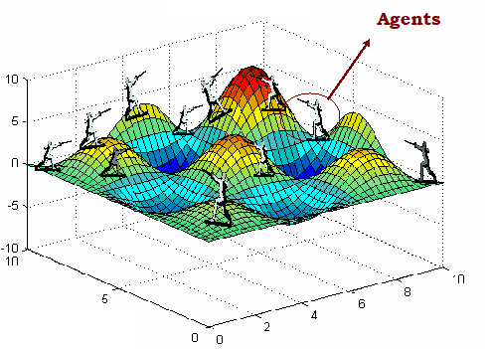
Differential Evolution

Slide 75
Motivation for Differential Evolution (DE)
A stochastic population-based algorithm for continuous function optimization (Storn and Price, 1996).
Stochastic, population-based optimisation algorithm developed to optimise real parameter, real valued functions.
Continually exhibited remarkable performance in competitions on different kinds of optimization problems like dynamic, multi-objective, constrained, and multi-modal problems.
The key element distinguishing DE from other population-based techniques is differential mutation operator

Slide 76
Why use Differential Evolution?
Global optimization is necessary in the fields such as engineering, statistics and finance
But many practical problems have objective functions that are non-differentiable, non-continuous, non-linear, noisy, flat, multi-dimensional or have many local minima, constraints or stochasticity
Such problems are difficult if not impossible to solve analytically
DE can be used to find approximate solutions to such problems.
A new heuristic approach for minimizing possibly nonlinear and non-differentiable continuous space functions .

Slide 77
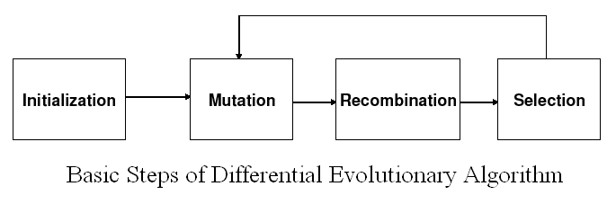
Basic DE algorithms – a first look
DE is an Evolutionary Algorithm
This class also includes Genetic Algorithms, Evolutionary Strategies and Evolutionary Programming
DE optimizes a problem by initializing a population of candidate solutions, creating new candidate solutions by combining the current solutions which is then crossed over, and selecting the best one according to a condition.

Slide 78
Notation
Suppose we want to optimize a function with D real parameters
We must select the size of the population; NP
The parameter vectors have the form:
x_{i,G} = [x_{1,i,G,} x_{2,i,G,} . . . x_{D,i,G}] i = 1, 2, . . . ,N.
where G is the generation number

Slide 79
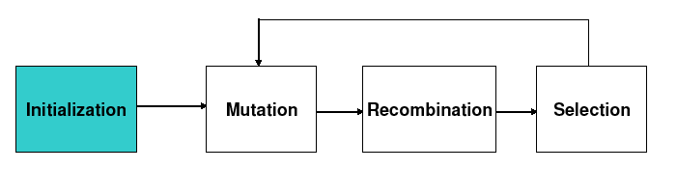
Initialization
First, all parameter vectors in a population are randomly initialized and evaluated using the fitness function
Define upper and lower bounds for each parameter:
Randomly select the initial parameter values uniformly on the intervals

Slide 80
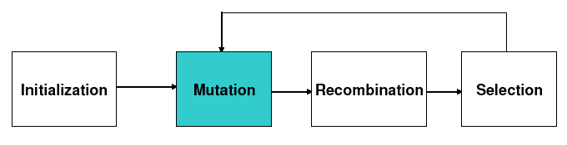
Mutation
Mutation expands the search space
For each vector select three other parameter vectors randomly
Add the weighted difference of two of the vectors to the third
V_{i,G+1} = X_{r1,G} + F(X_{r2,G} − X_{r3,G})
where V_{i,G+1} is a mutant vector; r1,r2,r3 ∈ {1, 2, …, NP}, random integer mutually different and different from index i and NP≥4
The mutation factor F is a constant from [0, 2]
V_{i,G+1} is called the donor vector

Slide 81
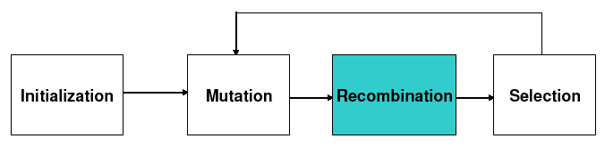
Recombination/Crossover
Crossover is introduced to increase the diversity of the perturbed parameter vectors
Recombination incorporates successful solutions from the previous generation
The trial vector U_{i,G+1} is developed from the elements of the target vector, X_{i,G}, and the elements of the donor vector, V_{i,G+1}
Elements of the donor vector enter the trial vector with probability CR

Slide 82
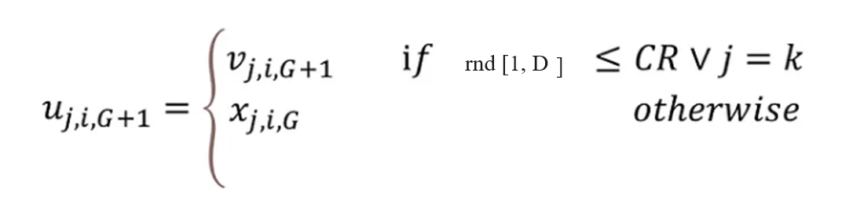
Crossover
k = rnd[1, D]
CR is a real valued crossover factor in the range 0 and 1.
It controls the probability that a trial vector will come from the mutant vector instead of the current vector.

Slide 83
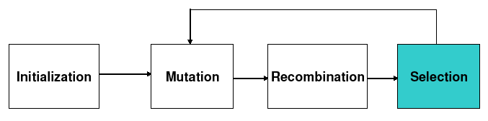
Selection
The target vector X_{i,G} is compared with the trial vector V_{i,G+1} and the one with the lowest function value is admitted to the next generation
X_{i,G+1}= U_{i,G} if f(U_{i,G}) ≤ f(X_{i,G})
= X_{i,G} otherwise
for i= 1,2,….,NP
Mutation, recombination and selection continue until some stopping criterion

Slide 84
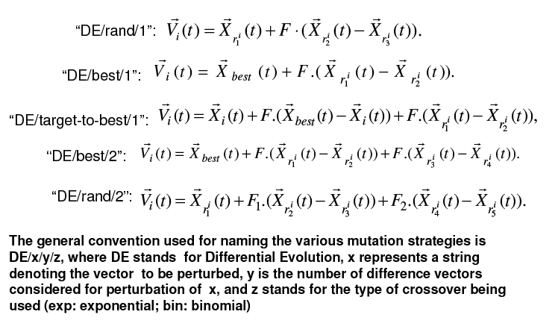
Frequently used DE mutation schemes

Slide 85
DE Control Parameters
Population size
Larger - increases the reliability - slower convergence
suggested ranges - 5 x n to 10 x n
F (scaling factor)
Range (0,1+)
Large – decreases convergence speed – escape local optima
CR (cross-over rate)
Range (0,1)
Large - speeds up convergence
Range (0, 0.2) – good for separable problems
Range (0.9, 1.0) – good for linked and multi-modal
problems

Slide 86
References:
Introduction to Genetic Algorithms, M. Mitchell, MIT press, 1996
Genetic Algorithms in Search, Optimisation and Machine Learning, D.E. Goldberg,
Addison-Wesley 1989
An introduction to Genetic Algorithms for Scientists and Engineers, D. A. Coley,
World Scientific 1999.
Optimization for Engineering Design – Algorithms and Examples, Kalyanmoy Deb,
P.H.I.

